Slide 1
Industrializing Broadcast-Quality Streaming
Adam Bedwell
VP – CTO/Sales Engineering - Americas

Slide 2
All Content And All Screens Are Not Equal
Are the expectations the same?

Slide 3
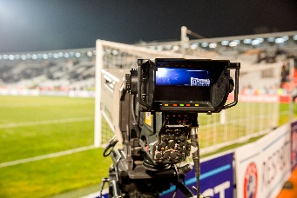
Conventional Broadcast vs OTT Latency
Example latencies with 6-second segments
Contribution
Program distrib.
Broadcaster encode
Cable encode
TV
0.5
2
4
4
CDN
Packaging
Client
OTT
0.5
2
4
6
6
3x 6
Write and post
Social
Media
10
Time after live edge
Live edge
at event

Slide 4
Industry Initiatives to Improve Latency
DASH CMAF Low-Latency
HLS Low-Latency Extensions
MP4 file media container
Divides each segment into smaller fragments, but stays one-file-per-segment
HTTP/1.1 Chunked Transfer Encoding to deliver fragments when available
MP4 or TS media container
Divides each segment into smaller discrete "part" files, each transferred separately
HTTP/2 push mode required for low latency
Frequent updates to manifest
Multiple manifest permutations depending on the URL request
Both can eliminate some of the latency, as long as fully implemented end-to-end
Neither removes the need for the client to have a significant buffer for rate
detection and adaptation

Slide 5
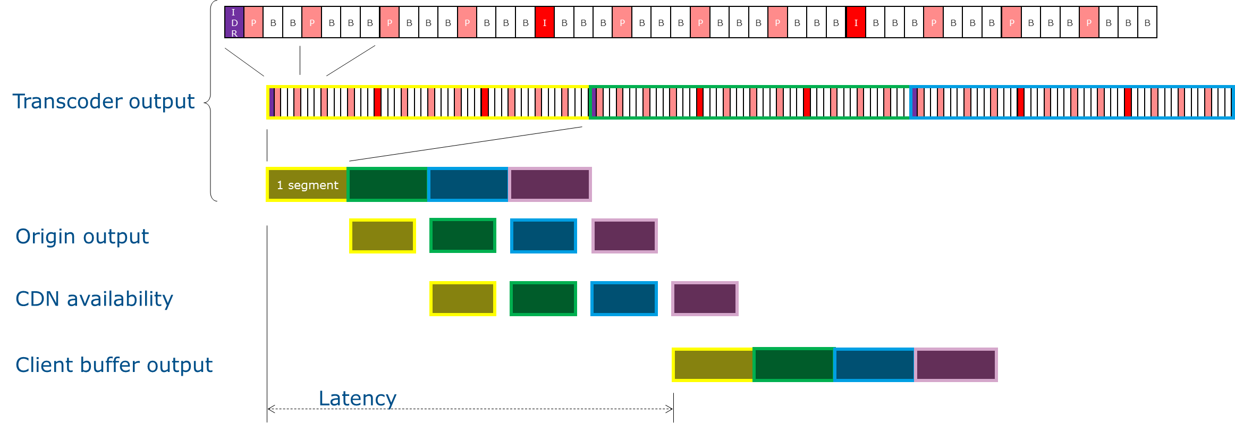
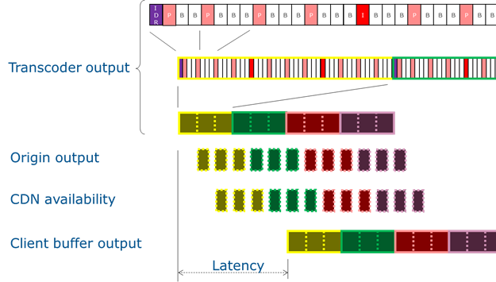
DASH Fragmentation & Chunked Transfer
Use HTTP/1.1 chunked transfer to move data as soon as available
Full-segment processing
With Fragments and CTE
In theory, could be 1 picture per fragment, but this leads to very small transfer sizes
and doesn't materially help vs (say) 8-frame chunks, because the reordering buffer is still needed
Chunked transfer, or the use of part files, makes measuring download rate more inaccurate

Slide 6
What about Scalability & Quality
98.2M
Streaming needs to scale up massively
more like 100x in terms of delivered bit rate
Client buffering/rate adaptation isn't acceptable
The real need is:
Consistently high quality
Scale
Low latency
All three are needed simultaneously
Viewers
~ 40x
Bit Rate
~ 3x
2.6M
Streaming
Broadcast
2019 Superbowl
Viewer Numbers
Typical Bit
Rate Comparison

Slide 7
Multicast For Scalability
Multicast sender & proxy, as per CableLabs MABR
Network
Home
Conventional
Unicast
ABR system
Request segment
CDN node
ABR client
Multicast push
at media rate
Multicast
ABR system
Real-time flow
of segments
Multicast
server
Multicast
Proxy
ABR client
CDN node

Slide 8
Latency is Impaired
Contribution
Program Distribution
Broadcaster encode
Cable encode
TV
0.5
2
4
4
Packaging
Additional MABR Latency
Client
CDN
OTT +
MABR
0.5
2
4
6
6
6
3x 6
Write and post
Social
Media
10
Time after live edge
Live edge
at event

Slide 9
Multicast-native into the Client
ABR – but with multicast scale and delivery guarantees
Where scale, quality & latency matter
Where reach matters most
Use a native multicast mechanism
Eliminates the large client buffer
Multicast scalability
Only fall back to OTT-mechanisms when multicast not available
ALC+LCT (used by 5G mobile & others) provides a good starting point
Send fragments
Rates managed by the network
Flow controlled to guarantee delivery
Clients can use any of:
Conventional ABR (OTT)
Multicast proxy
Multicast native
Maximum client reach

Slide 10
Match the tech to the need.
Meet expectations, for every screen type
Multicast low latency ABR
OTT wide-reach ABR

